Slide 1
EYE POINT AI - DEVELOPMENT
PANIMALAR ENGINEERING COLLEGE
Computer Science and Engineering
Batch No: C27
GUIDE NAME: Dr.N.PUGHAZENDI, M.E., Ph.D., Profesor
Ashwin Sanjay J
211420104030

Slide 2
Table of contents
01
06
02
07
03
08
04
09
05
Introduction
Literature Survey
Abstract
System Architecture
Existing System
Module Description
Proposed System
UI & UX Design
Key Features

Slide 3
Introduction
Gaze tracking technology monitors and interprets a person's gaze direction, offering insights into human-computer interaction, psychology, and physiology. By capturing and analyzing eye movements, it provides a deeper understanding of user behavior and engagement.
In HCI, gaze tracking optimizes interfaces in real-time, enhancing user experience across various fields like VR, AR, gaming, and assistive technologies. In psychology, it aids in studying cognitive processes and behavior, contributing to advancements in cognitive science and neuromarketing.
Gaze tracking also plays a role in healthcare, facilitating early diagnosis of neurological disorders and empowering individuals with motor impairments through assistive technologies.

Slide 4
Abstract
EyePoint revolutionizes user interaction through precise gaze mapping onto computer monitors.
Using cutting edge AI algorithms, it achieves real-time iris tracking with standard webcams, offering a cost-effective solution.
The 'Fun Window' feature enhances engagement, while robust security measures protect privacy.
Compatible across platforms, EyePoint enhances learning experiences and provides valuable insights in behavior research, making advanced gaze tracking accessible and transformative.

Slide 5
Existing System
Critical Component for Accuracy and Reliability :
Integration of an eye-tracking device uses hardware component utilizes advanced sensors to capture intricate eye movements, providing the necessary data for comprehensive gaze tracking.
Wearable Devices :
Some wearable devices, such as smartwatches and augmented reality glasses, are beginning to incorporate gaze tracking as a feature. These devices often use sensors and cameras to track eye movements and can provide feedback or control based on where the user is looking.
Disadvantage : Use External Sensors or Hardware to capture gaze data.

Slide 6
Proposed System
Key Benefits :
The “Eye Point" aims to provide a comprehensive and efficient solution for tracking eye with cutting edge AI Algorithms aiming High Accuracy with the standard webcams available in the laptops.
Cost-Efficient and Accessible Technology
Precise Precision and Accuracy
User-Friendly
Achieved with Webcams : By leveraging existing hardware, our approach offers a cost-effective alternative to traditional eye-tracking devices, reducing financial barriers for adoption.

Slide 7
Literature Survey
S.NO. | TITLE | AUTHOR & JOURNAL | INFERENCE
1 | Evaluation of appearance-based eye tracking calibration data selection | Yuqing Li, Yinwei Zhan, Zhuo Yang | This research highlights the importance of careful calibration data selection in appearance-based eye tracking.The study demonstrates that a thoughtful calibration strategy, even with a minimal number of targets, significantly improves gaze estimation accuracy,
2 | Classification of Eye Tracking Data using a Convolutional Neural Network | Yuehan Yin, Chunghao Juan, Joyram Chakraborty, Michael P. McGuire | The study involves the preprocessing of eye tracking data, storage in MongoDB, and feature engineering to enhance machine learning model performance. The use of Keras facilitates model development, and evaluation metrics provide a comprehensive assessment of classifier effectiveness.

Slide 8
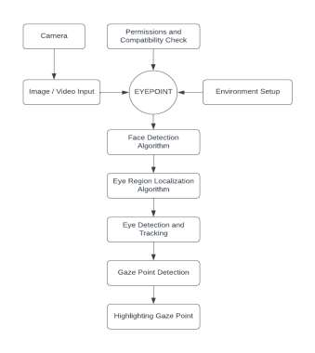
System Architecture
The first step is a permissions and compatibility check. The system then captures an image or video input. From here, an eyepoint device is used to set up the environment.
Face detection involves several steps: localizing the eye region within a detected face, identifying eyes within this area, and tracking their movement over time. Gaze point detection analyzes eye movements to determine the precise point on the screen where the user is looking. Finally, the system visually highlights the gaze point, providing clear feedback on the user's focus area. This process enables accurate interaction with eye-tracking systems for applications such as user interface optimization and immersive experiences.

Slide 9
Module Description
EYE POINT consists of 3 main modules. They are
AI Engine
Web Application
Fun Window
AI ENGINE:
The AI Engine powers sophisticated eye-tracking software, decoding intricate eye movement
data for meticulous analysis and precise response to users' gaze behavior. Leveraging advanced artificial intelligence, it enables seamless and accurate interaction across various applications, from enhancing virtual reality experiences to revolutionizing human-computer interactions.

Slide 10
WEB APPLICATION :
Our web application seamlessly integrates with eye-tracking software, offering easy access features.
The application features an intuitive design for a smooth and enjoyable user experience.
Users can effortlessly harness the full potential of eye-tracking functionalities without unnecessary complexities.
FUN WINDOW :
The application offers real-time visualization of the user's gaze, providing dynamic feedback.
Interactive features are incorporated to enhance user engagement and personalize interactions
By augmenting gaze visualization with interactive elements, the application creates a more engaging and
immersive experience.
The addition of interactivity and responsiveness contributes to a distinctive environment, elevating the
overall user experience.

Slide 11
M1: AI Engine
C1: Eye Tracker Processing
F1: Calibration over the Screen: Setting up the system to accurately track eye movements across the screen.
F2: Track Eyeball Movement: Following where the eyes are looking.
MF1: Real-time update of gaze coordinates: Continuously updating where the eyes are looking on the screen.
MF2: Accuracy in gaze tracking: Making sure the system accurately knows where the eyes are focusing.

Slide 12
C2: Calibrator
F1: User Interface: How users interact with the calibration process.
F2: Instructions and Guidelines: Providing guidance for users during calibration.
MF1: Clear and concise instructions: Making sure users understand what they need to do.
MF2: On-screen guidance during Calibration: Giving visual cues to help users calibrate accurately.
F3: Calibration Points: Points used during calibration.
MF1: Randomization of calibration points: Randomly selecting points to calibrate for accuracy.
F4: Collect Screen Data: Gathering information about the screen.
MF1: Efficient data collection: Making sure information is gathered quickly and effectively.

Slide 13
M2: Web Application
C1: Sys-Info Collector
F1: Camera Permissions: Managing access to the camera.
MF1: User prompts for camera access: Asking users for permission to use the camera.
MF2: Permission handling: Making sure only authorized users can access the camera.
F2: Screen Width: Determining the width of the screen.
MF1: Automatic detection of screen width: Automatically figuring out how wide the screen is.

Slide 14
C2: User Interface
F1: Make sure face is visible: Ensuring the system can see the user's face.
MF1: Fit face in the circle to detect: Adjusting the camera view to capture the user's face.
F2: Start Calibration Button: Initiating the calibration process.
MF1: Clearly visible calibration initiation button: Making sure users can easily find and start calibration.
MF2: Interactive design: Creating a button that users can click on to start calibration.
F3: Calibration Screen: The interface during calibration.
MF1: User-friendly calibration interface: Making sure the calibration process is easy for users to understand and follow.

Slide 15
C3: iCleanser-AI
F1: Face Finder: Identifying faces in images.
MF1: Face detection algorithm: Using a program to recognize faces.
MF2: Robust against varying lighting conditions: Working well even if the lighting changes.
F2: Frame Reducer: Decreasing the number of frames captured.
MF1: Real-time reduction of captured frames: Removing unnecessary frames quickly.
F3: Cleanser: Improving the quality of images.
MF1: Image enhancement for better analysis: Making images clearer for analysis.

Slide 16
F4: Uploader: Sending data to another location.
MF1: Efficient upload of processed data: Sending information quickly.
MF2: Secure data transmission: Making sure the data is sent safely.
C4: Backend Receiver
F1: Filtered Image: Images processed on the backend.
F2: Image Processor: Handling images received from the frontend.
MF1: Efficient processing of facial data: Analyzing facial information quickly.
MF2: Compatibility with different image formats: Being able to work with various types of images.

Slide 17
M3: Fun Window App
C1: Fun Box
F1: Receive Coordinates from Backend: Getting information about where the user is looking.
MF1: Real-time reception of gaze coordinates: Getting this information quickly.
F2: Highlight the Coordinates: Making the gaze coordinates stand out.
MF1: Visual effects to highlight received coordinates: Adding effects to make the gaze coordinates noticeable.
MF2: Dynamic highlighting based on user gaze movements: Changing the highlighting based on where the user is looking.

Slide 18
Methodology
CNNs analyze eye images pixel by pixel, capturing intricate details like edges, textures, and shapes.
They learn hierarchical representations of eye features, enabling accurate gaze estimation based on learned patterns.
CNNs model complex, non-linear relationships between input eye images and gaze coordinates, enabling accurate mapping between visual features and gaze directions.
Pre-trained CNN models on large-scale datasets can be fine-tuned for gaze tracking tasks, leveraging learned representations to improve performance with limited annotated gaze data.
CNNs offer robustness to variations in lighting conditions, head poses, etc,.

Slide 19
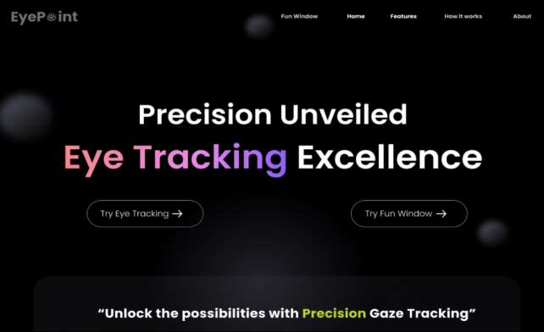
UI & UX Design
Landing Page

Slide 20
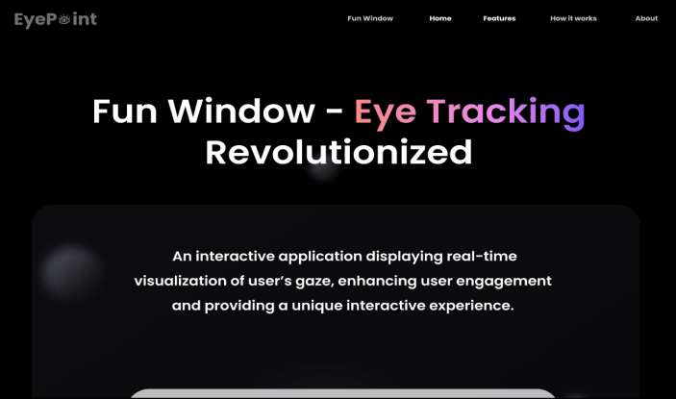
Fun Window Page

Slide 21
Thank you

